Slide 1
Factors affecting the depth of field for SEM
Afshin Jooshesh

Slide 2
outline
Introduction and definition of Depth of field
DOF equation
Example
Enhancement

Slide 3
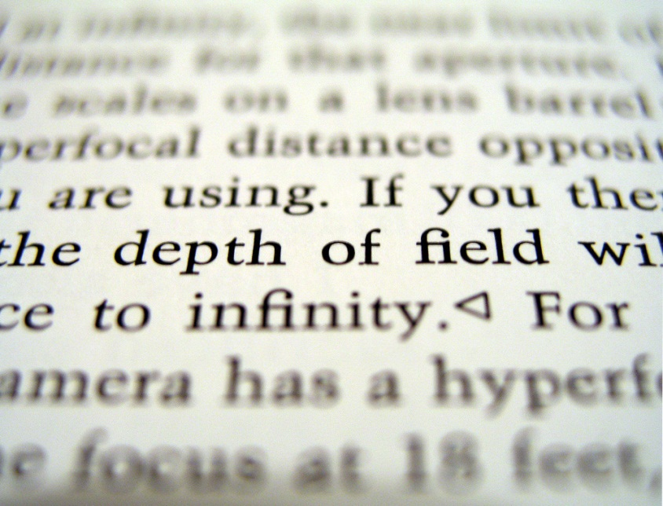
Depth of Field
Is the distance of the nearest and farthest object from the detector if it appears sharp and with enough details.

Slide 4
Depth of Field
In optics DOF is defined as
Which depends on the focal length of the lens, the f-number of the lens opening (the aperture), and the camera-to-subject distance.
f is the lens focal length, N is the lens f-number, and c is the circle of confusion.
in SEM systems DOF is dependent to two variables
the final aperture size (radius R)
the working distance (W)

Slide 5
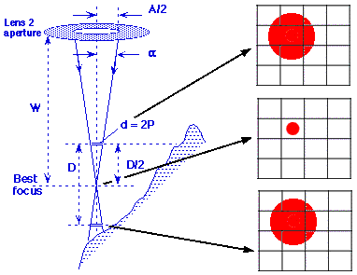
Depth of Field
At some distance D/2 above and below the focus plane the diameter of the beam becomes twice the pixel diameter for the mag being used, whereupon the signals from adjacent pixels overlap enough to cause the image to appear blurred. Over the distance D, the image will appear to be in acceptably sharp focus, and so this distance is called 'the depth of field‘.

Slide 6
Some effects
DOF will be larger when the emission disc is smaller
DOF will be larger when the aperture is smaller
DOF will be larger higher when the working distance is longer
DOF will be larger when the SEM is at lower magnifications

Slide 7
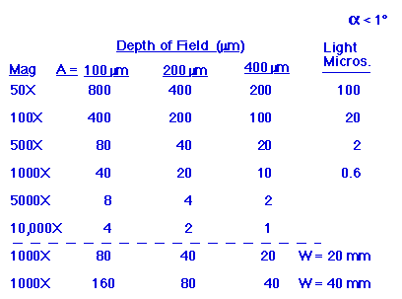
Example
for a specimen At working distance of 10mm we Can find D in different conditions

Slide 8
Enhancement of DOF
Namely, to increase the depth of field we must either:
decrease the size of the aperture in the final lens A
decrease the magnification M being used, or
increase the distance W between the specimen and the lens

Slide 9
Decreasing the size of the aperture
can produce an increased depth of field
a decrease in probe current
a possible improvement in the probe resolution
a change in astigmatism (needs to be corrected again)

Slide 10
increasing the distance W
* Can potentially increased depth of field
* lower attainable limits for low magnification
* some loss of resolution
* a possible decrease of signal strength
* astigmatism will worsen at long W
* some serious distortions in

Slide 11
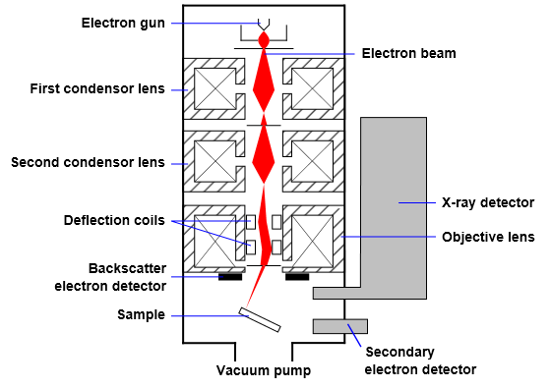
Thank you

